Slide 1
Google map
(Application Programming Interface)

Slide 2
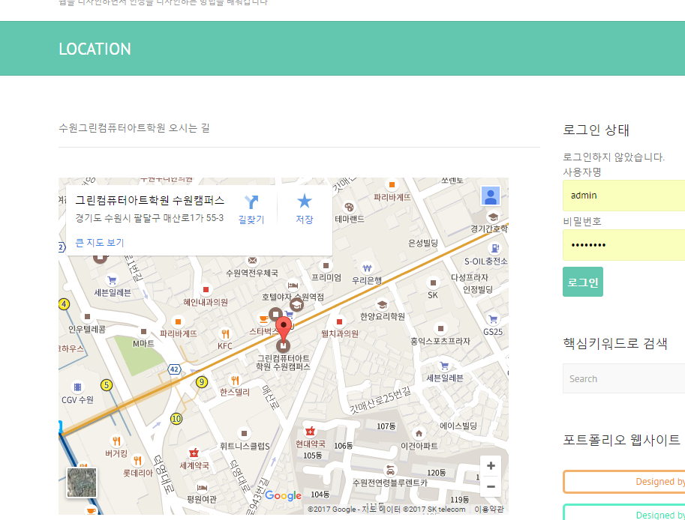

Slide 3
구글에서 ‘google map developer , google map’
키워드로 검색
https://developers.google.com/maps/?hl=ko
<!DOCTYPE html>
<html>
<head>
<style type="text/css">
html, body { height: 100%; margin: 0; padding: 0; }
#map { height: 100%; }
</style>
</head>
<body>
<div id="map"></div>
<script type="text/javascript“>
var map;
function initMap() {
map = new google.maps.Map(document.getElementById('map'), {
center: {lat: -34.397, lng: 150.644},
zoom: 8
});
} </script>
<script async defer
src="https://maps.googleapis.com/maps/api/js?key=YOUR_API_KEY&callback=initMap">
</script>
</body>
</html>

Slide 4
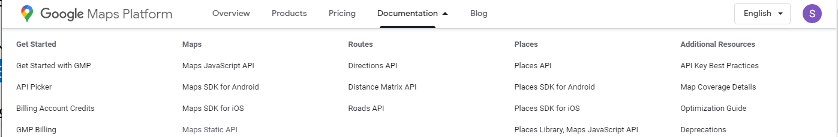
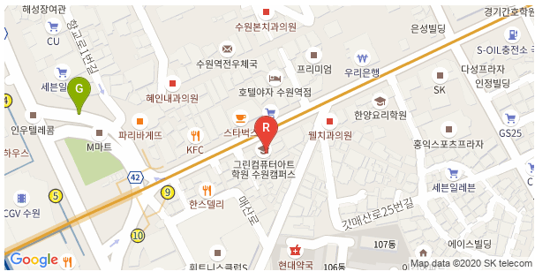
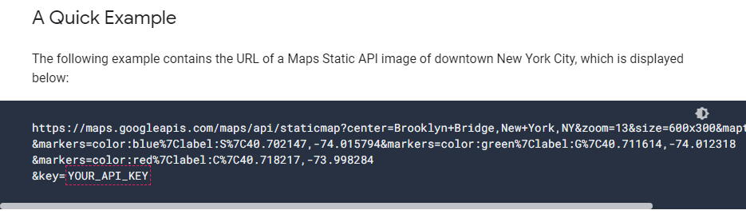
1. 정적인 맵 static map : img태그의 src속성값 활용
https://developers.google.com/maps/documentation/maps-static/overview

Slide 5
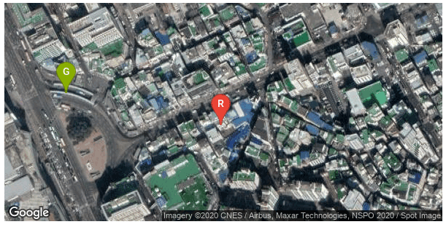
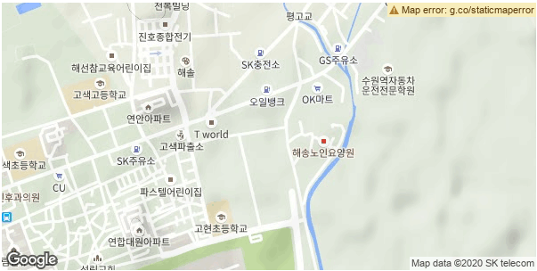
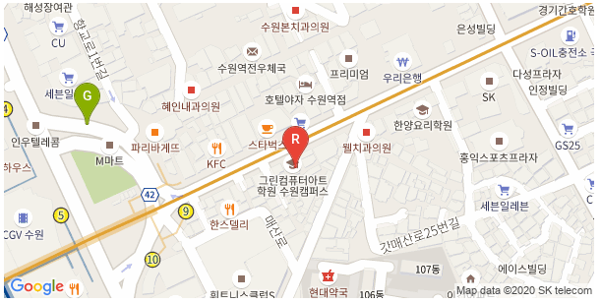
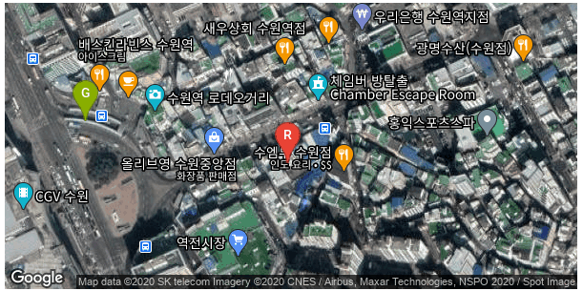
지도 스타일 변경
satellite
terrain
roadmap
hybrid

Slide 6
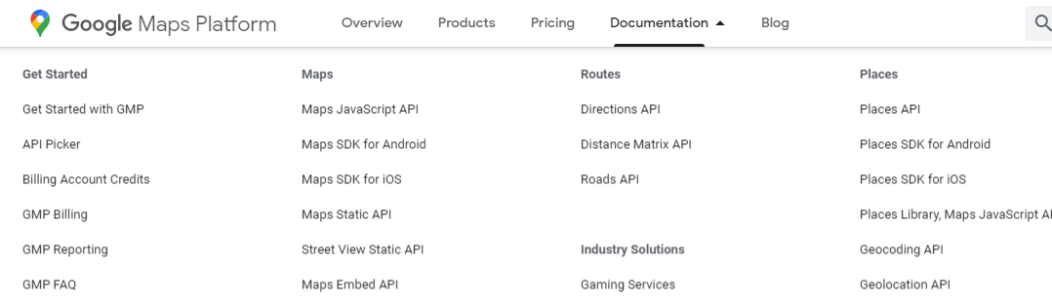
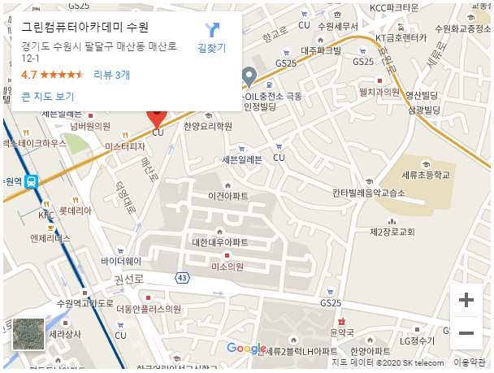
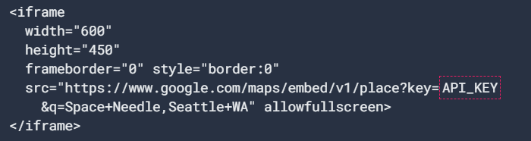
2. 동적인 맵 embed API : iframe태그 활용
https://developers.google.com/maps/documentation/embed/get-started

Slide 7
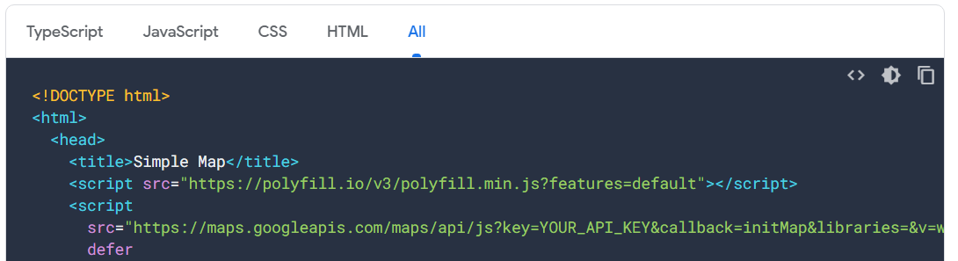
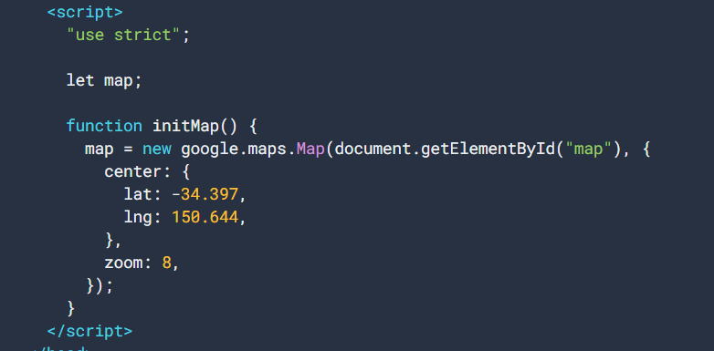
3. 동적인 맵 javascript API : script활용
https://developers.google.com/maps/documentation/javascript/overview
변경해야 하는 부분
YOUR_API_KEY
찾는 지점
https://maps.google.com/ 에서 검색
줌 수치

Slide 8
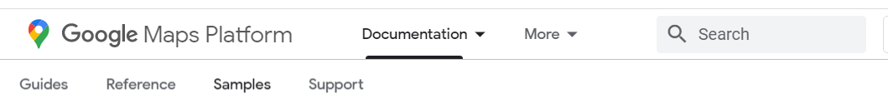
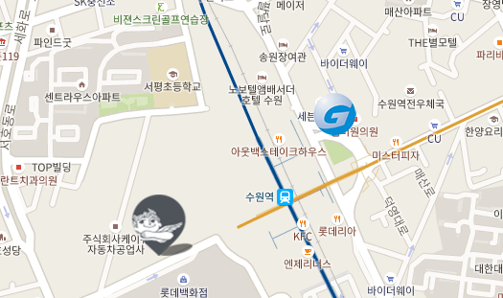
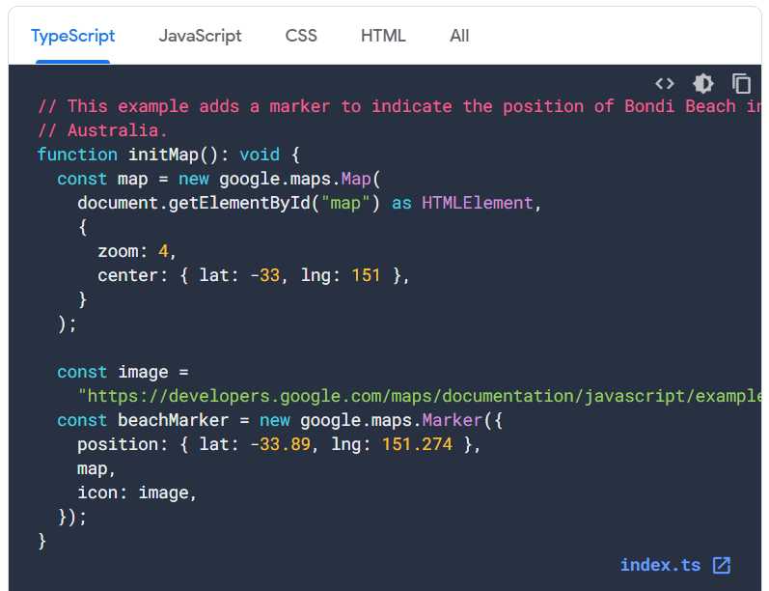
4. 사용자 마커 : script활용
https://developers.google.com/maps/documentation/javascript/examples/icon-simple?hl=ko

Slide 9
5. 애니메이션 마커 : script활용
https://developers.google.com/maps/documentation/javascript/examples/marker-animations?hl=ko

Slide 10
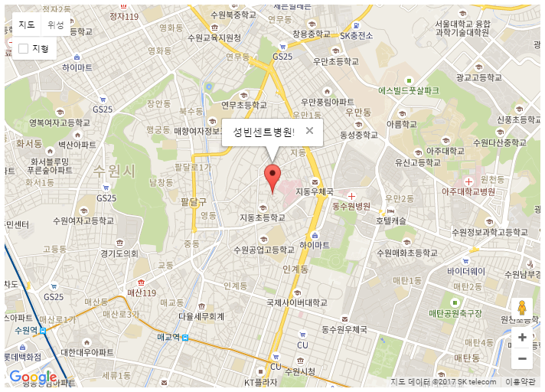
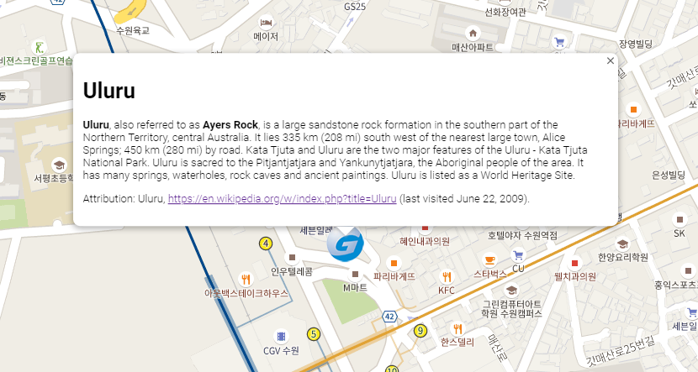
그외 UI : InfoWindow map
https://developers.google.com/maps/documentation/javascript/examples/marker-animations?hl=ko

